Slide 1
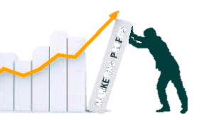
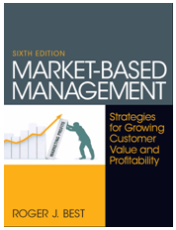
Market-Based Management
MBM 6th
Edition
Gains in marketing knowledge without application lessen the full impact of learning.
Performance
Impact
Marketing
Application
Marketing
Knowledge
The objective of Market-Based Management is to go beyond theory to provide readers with the necessary concepts and tools to apply what they have learned and understand the performance impact of Market-Based Management.
– Roger J. Best
Copyright Roger J. Best, 2012

Slide 2
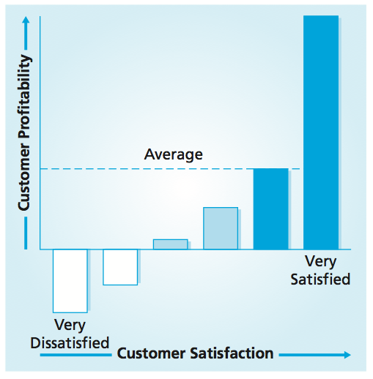
Customer Focus, Customer
Performance, and Profit Impact
MBM6
Chapter 1
Very Satisfied Customers Drive Profits
Chapter 1 Objectives
Building a customer focused organization
Measuring customer performance
Profit impact of customer retention and customer loyalty.
Satisfied is not good enough. Completely satisfied—that’s a big deal. A completely satisfied customer is at least three times more likely to return than one who’s just satisfied.
―Andrew Taylor, CEO, Enterprise Rent-A-Car
Copyright Roger J. Best, 2012

Slide 3
Customer Focus, Customer
Performance, and Profit Impact
MBM6
Chapter 1
Building a Customer-Focused Organization
In this section we will look at how customer-focused organizations not only outperform their competition over the long term by consistently delivering higher levels of customer satisfaction, they also realize higher profits over the short run.
Copyright Roger J. Best, 2012

Slide 4
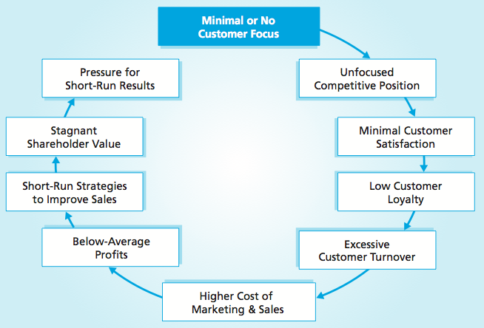
MBM6
Chapter 1
Underwhelming Customers
Little or no customer focus translates into an unfocused competitive position and minimal customer satisfaction. The result is a vicious circle of poor performance.
Copyright Roger J. Best, 2012

Slide 5
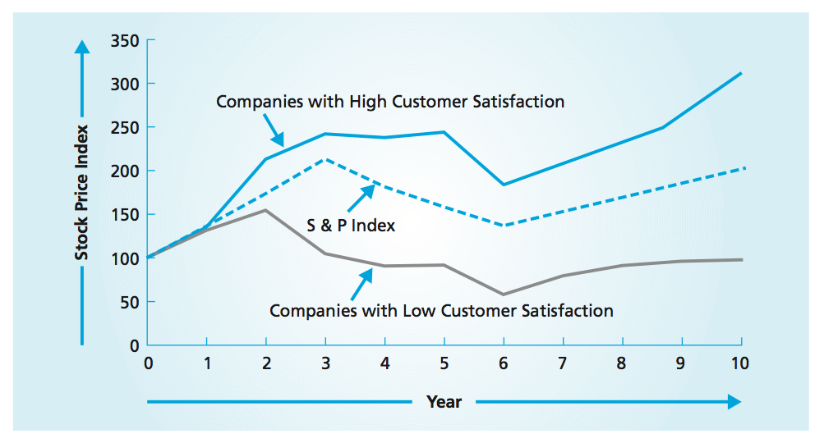
Top Performers Produce Higher Investor Returns
MBM6
Chapter 1
Apple, Southwest Airlines, and Clorox would be a part of the top performers in the graph above. Their average stock price index started at 100 and 10 years later was 300. Poor performers started at 100 and 10 years later were still at 100.
Copyright Roger J. Best, 2012

Slide 6

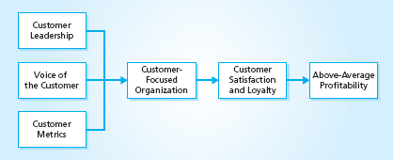
Customer-Focused Organization
MBM6
Chapter 1
Senior Mgmt Leadership
Employee Customer Training
Customer Involvement
Customer Experiences
Customer Solutions
Customer Complaints
Customer Satisfaction
Customer Retention
Customer Loyalty
How would this model work differently in Bank of America vs. Southwest Airlines?
Copyright Roger J. Best, 2012

Slide 7
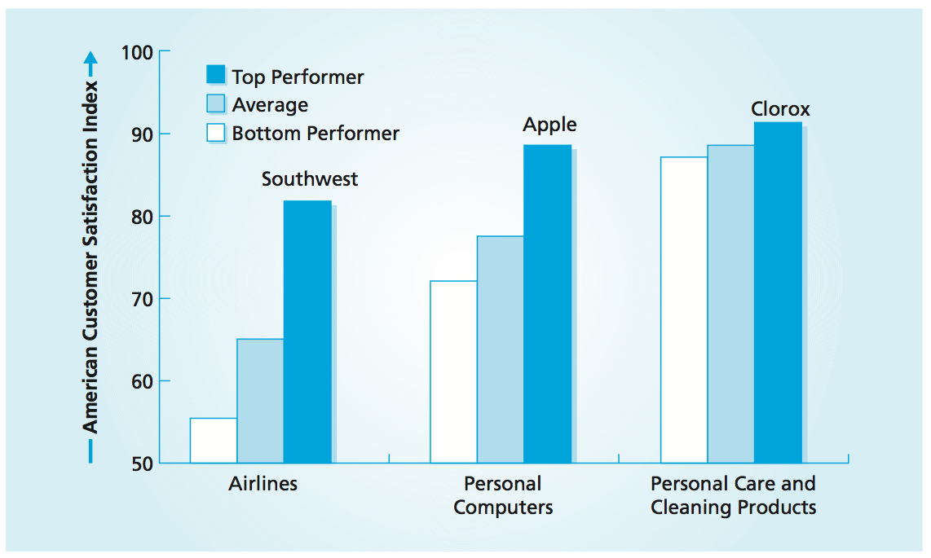
MBM6
Chapter 1
Benchmarking Customer Satisfaction
American Customer Satisfaction Index - University of Michigan (www.theACSI.org)
ACSI studies have shown that Customer Satisfaction is a leading indicator of company financial performance. The ACSI database reports all companies by industry.
Copyright Roger J. Best, 2012

Slide 8
Customer Focus, Customer
Performance, and Profit Impact
MBM6
Chapter 1
Measuring Customer Performance
In this section we will look at how companies that use customer performance metrics are able to identify their unprofitable customers. For any business, knowing which customers not to attract is just as important as knowing which customers to attract.
Copyright Roger J. Best, 2012

Slide 9
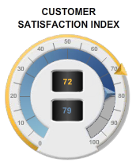
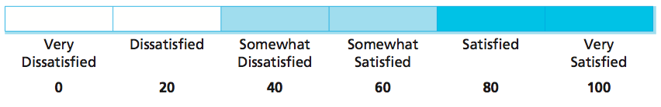
Customer Satisfaction
A Key Performance Metric
MBM6
Chapter 1
Very
Satisfied
100
Satisfied
80
Somewhat
Satisfied
60
Somewhat
Dissatisfied
40
Dissatisfied
20
Very Dissatisfied
0
To determine the CSI for a sampling of customers, simply compute the average of the customers’ satisfaction ratings. Customer satisfaction is a forecast of future revenues and profits.
Copyright Roger J. Best, 2012

Slide 10
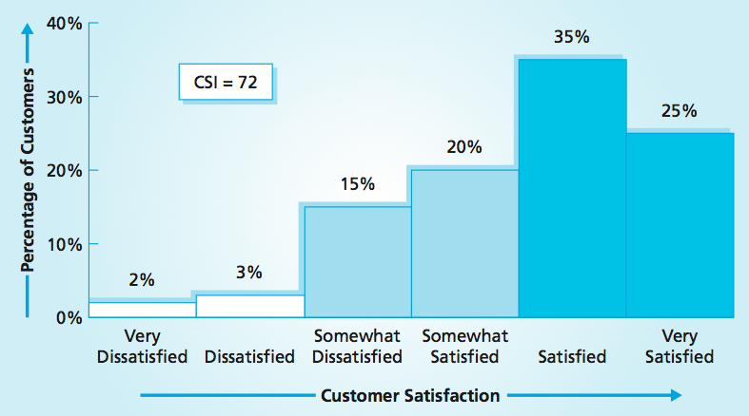
Customer Satisfaction – Wide-Angle View
MBM6
Chapter 1
De-averaging CSI provides a wide-angle view of customer satisfaction and allows managers to see more completely the opportunities for improvement.
Copyright Roger J. Best, 2012

Slide 11
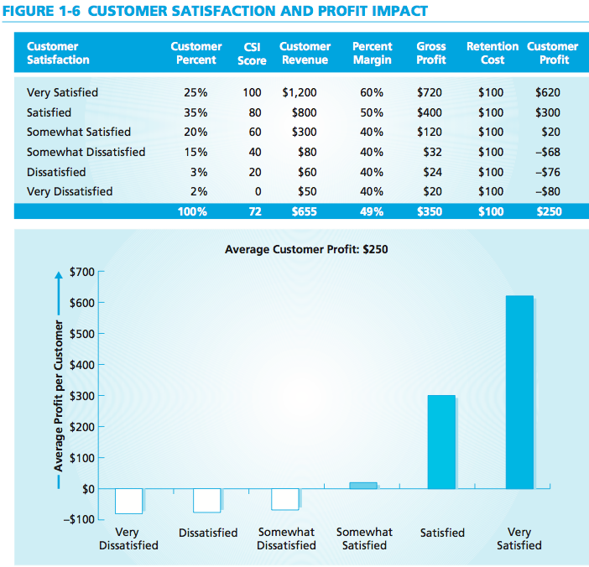
Profit Impact of Very Satisfied Customers
Marketing Performance Tool 1.1
De-averaging CSI is critical to understanding customer profitability
“Very satisfied” customers not only buy more, they often buy higher-margin products and services, which results in a higher percent margin on total sales.
Copyright Roger J. Best, 2012

Slide 12
Profitability of Satisfied Customers
MBM6
Chapter 1
When we chart customer profitability against customer satisfaction, we see that the “very satisfied” customers are the ones who drive profitability.
Copyright Roger J. Best, 2012

Slide 13
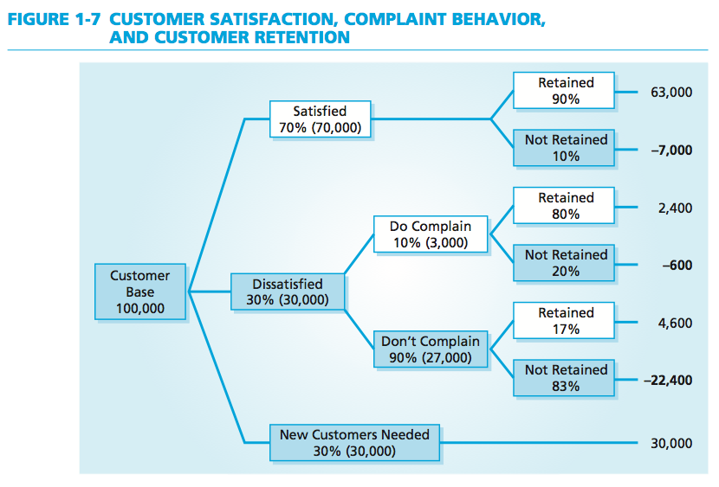
Complaint Behavior and Retention
Marketing Performance Tool 1.2
Dissatisfied customers often do not complain, but they do walk and they do talk.
Each year, the business above loses 22,400 customers who are dissatisfied, but do not complain.
Copyright Roger J. Best, 2012

Slide 14

Customer Dissatisfaction and
the Use of Social Media
MBM6
Chapter 1
Facebook as an Outlet for Customer Dissatisfaction
An individual’s car was towed despite being legally parked with a valid parking sticker. The individual created a Facebook page to express his dissatisfaction with the towing company.
More than 10,000 supporters, some using other social media, also expressed their dissatisfaction with the towing company.
Many related their own bad experiences, and 20 formal complaints were filed over a 3-year period as a result .
Copyright Roger J. Best, 2012

Slide 15
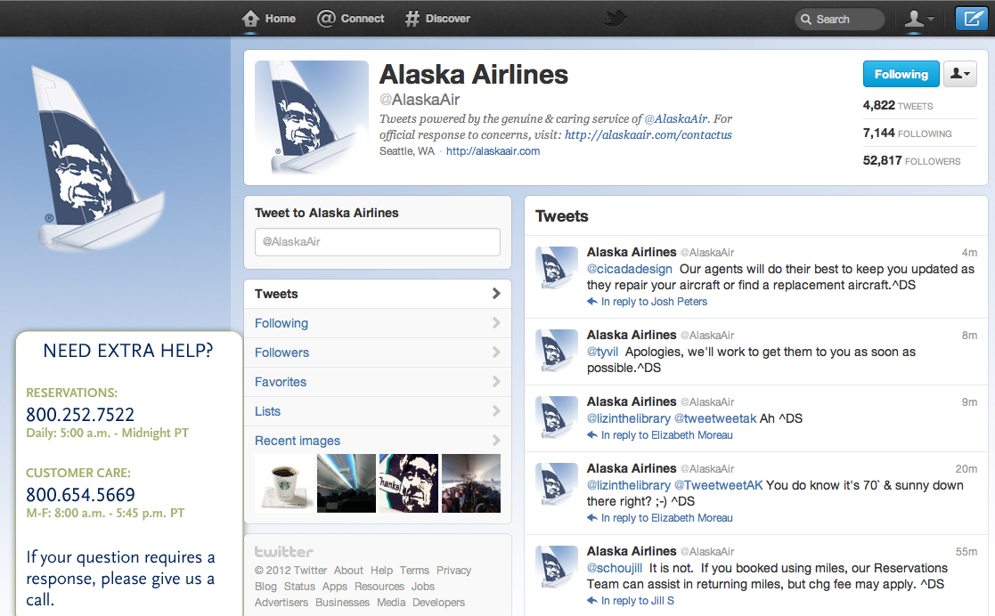
Managing the Customer
Experience with Twitter
MBM6
Chapter 1
Alaska Air uses twitter as a channel to promote new fares/routes and to field customer service issues. Their twitter page is a mix of responses to customers, promotions, and warnings of weather delays.
Copyright Roger J. Best, 2012

Slide 16
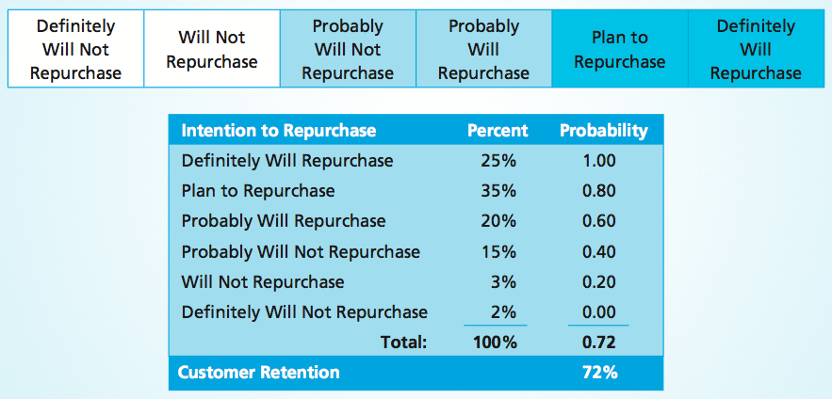
Estimating Customer Retention
MBM6
Chapter 1
How likely are you to buy this product or brand again on your next purchase?
To estimate retention rates, businesses can use a customer survey as outlined above.
Copyright Roger J. Best, 2012

Slide 17
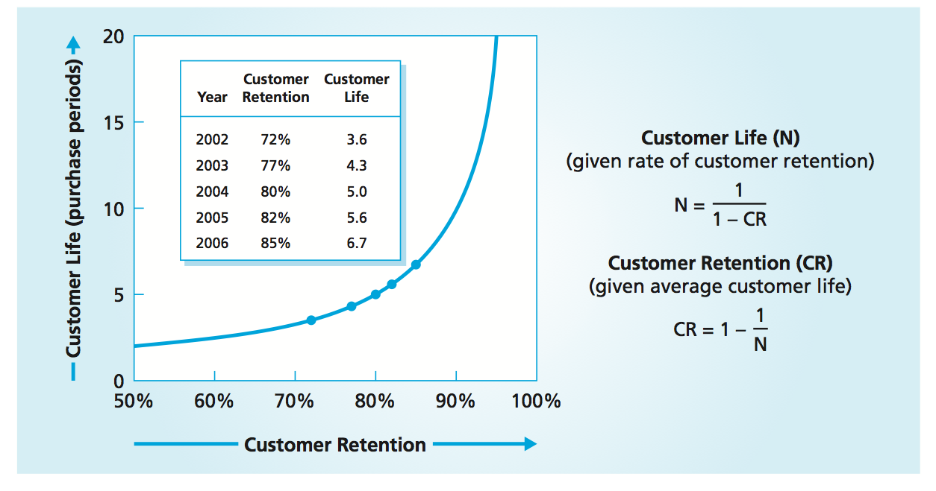
NetFlix Customer Retention
MBM6
Chapter 1
The Customer Lifetime Value increases exponentially with increases in Customer Retention.
How will the radical price increase of 60% in 2011 impact NetFlix’s customer retention?
Copyright Roger J. Best, 2012

Slide 18
Customer Performance and Profit Impact
MBM6
Chapter 1
Profit impact of customer retention and customer loyalty.
In this section we will look at how loyal customers have a longer customer history, are more committed to the company brand, buy more, and are more likely to recommend the brand to others.
Copyright Roger J. Best, 2012

Slide 19
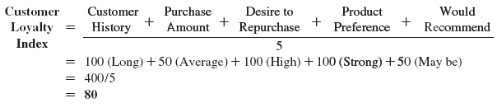
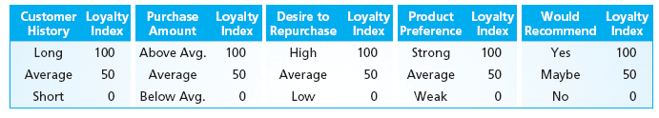
Assessing Customer Loyalty
MBM6
Chapter 1
Loyal customers have a long customer history, buy at an above-average purchase amount, have a high desire to repurchase, have strong product preferences for the company’s products and would recommend the company’s products to friends, relatives, and co-workers.
Copyright Roger J. Best, 2012

Slide 20
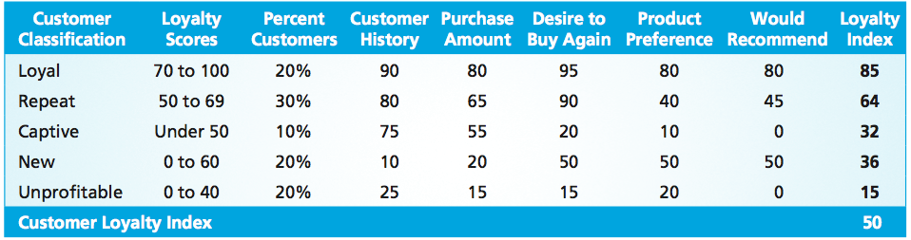
Managing Customer Loyalty
MBM6
Chapter 1
Loyal Customers – High performance in all five aspects of customer loyalty
Repeat Customers – Great customers that buy often but score lower on purchase amount, product preference, and customer recommendation.
Captive Customers – Have a long customer history and average purchase amount but would leave if they could, as they are dissatisfied captive customers.
New Customers – Score low on all aspects of customer loyalty as they do not yet have the customer history to assess their customer loyalty.
Unprofitable Customers – Score low on all aspects of customer loyalty.
Copyright Roger J. Best, 2012

Slide 21
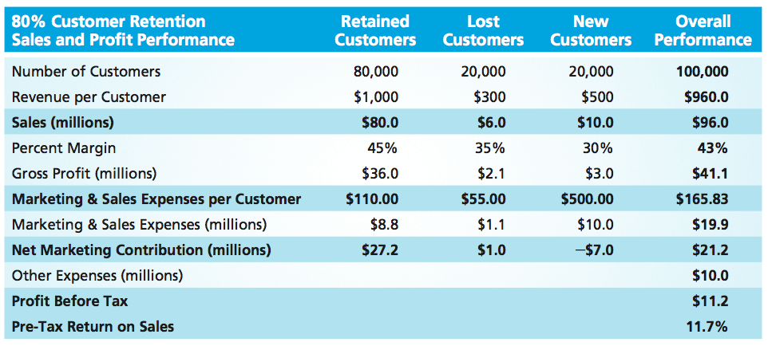
Customer Retention and Profitability
MBM6
Chapter 1
Placing a high priority on satisfying and retaining customers can provide tremendous financial leverage.
Every additional customer who is retained increases a business’s net profit.
Copyright Roger J. Best, 2012

Slide 22
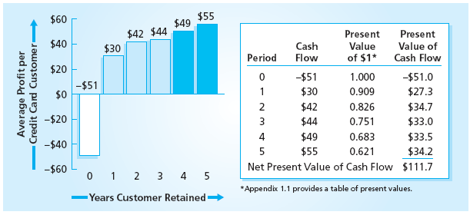
Customer Lifetime Value
Marketing Performance Tool 1.3
The average credit card customer for this company has a customer life of 5 years. It costs the company $51 to acquire a new customer and by year 5 they produce $55 in customer profit.
The lifetime value using a 10% discount rate is $111.70, the net present value of the customer cash flow over 5 years.
Copyright Roger J. Best, 2012

Slide 23
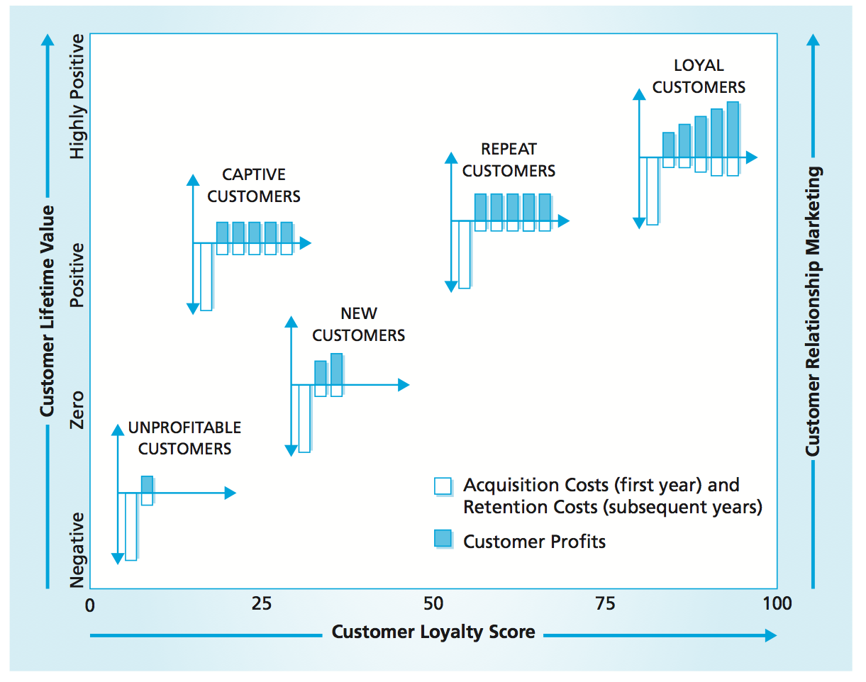
Customer Lifetime Value
and Customer Loyalty
MBM6
Chapter 1
Customer Loyalty Scores and Customer Lifetime Value are closely correlated.
Copyright Roger J. Best, 2012

Slide 24
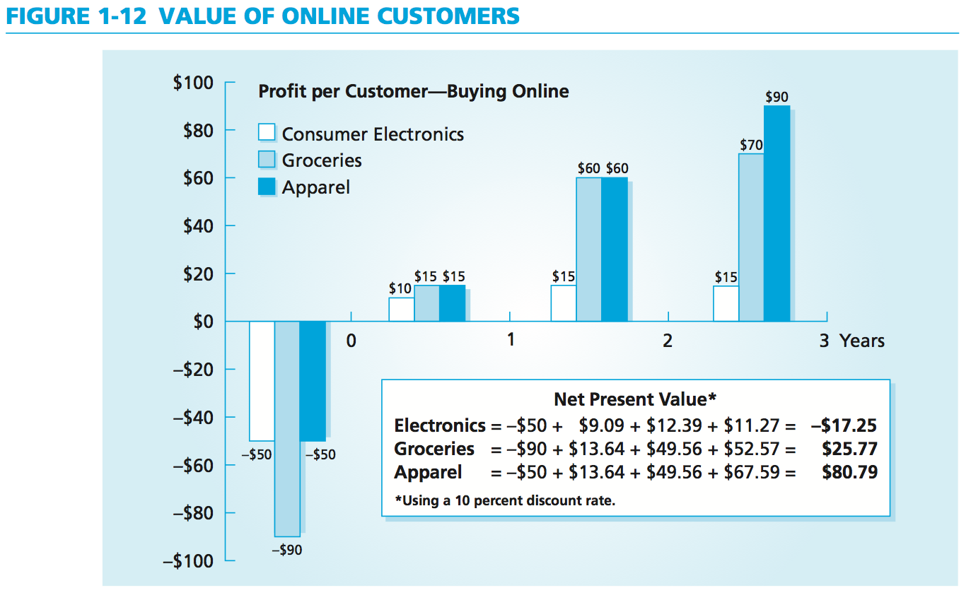
Value of Online Customers
MBM6
Chapter 1
The cost of acquiring an online grocery customer is almost twice the cost of acquiring an online consumer electronics or apparel customer.
Copyright Roger J. Best, 2012

Slide 25
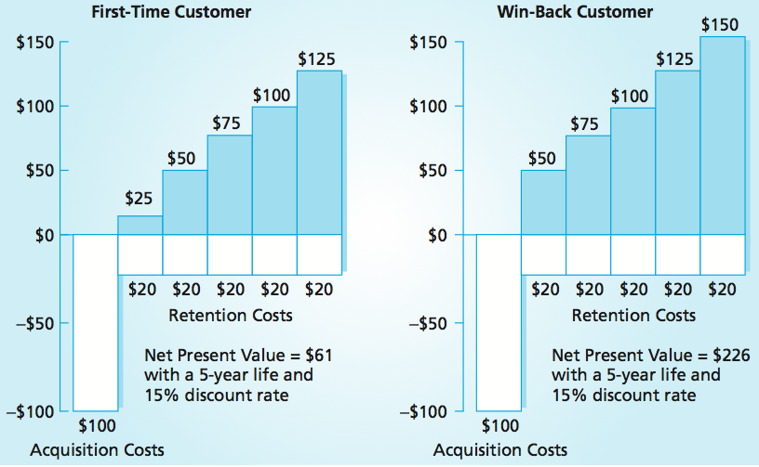
Customer Lifetime Value
Of Win-Back Customers
MBM6
Chapter 1
The return of a former customer is a lost opportunity that has reappeared— a second chance to develop a loyal customer.
The “second lifetime value” of a win-back customer has a net present value almost 3x higher than the average lifetime value of an entirely new customer.
Copyright Roger J. Best, 2012

Slide 26
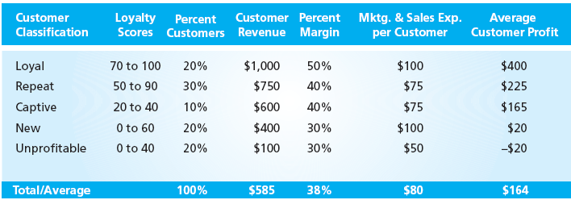
Marketing Performance Tool 1.4
Customer Loyalty & Customer Profitability
MBM6
Chapter 1
Loyal customers play an important role in company profitability. How would management of customer loyalty improve profits?
Copyright Roger J. Best, 2012

